Slide 1

Playing Catchup: Estimating Player & Positional Value in (American) Football
Paul Sabin
Sr Sports Analytics Specialist, ESPN
@SabinAnalytics

Slide 2
What is Player Value?
Monetary contributions
Winning contributions
Free-market salary
Cost of replacement

Slide 3
Estimates in Other Sports
Baseball
WAR, Win Shares, Win Probability Added (WPA)
Basketball
ESPN RPM, 538 Raptor, Win Shares, EPV, WPA
Hockey
RAPM

Slide 4
Estimating Value in Football
QBR
Quarterback only – attempts to divide credit based on video tracking
PFR Approximate Value (AV)
NFLScrapr WAR
Position player only – not full all 22 data
PFF WAR
Largely based on translating PFF scouting grades to winning

Slide 5
Goals
Framework for NCAA & NFL
Coarse-level model
As few assumptions as possible
Try to avoid human bias
Rely on data
Estimate positional value

Slide 6
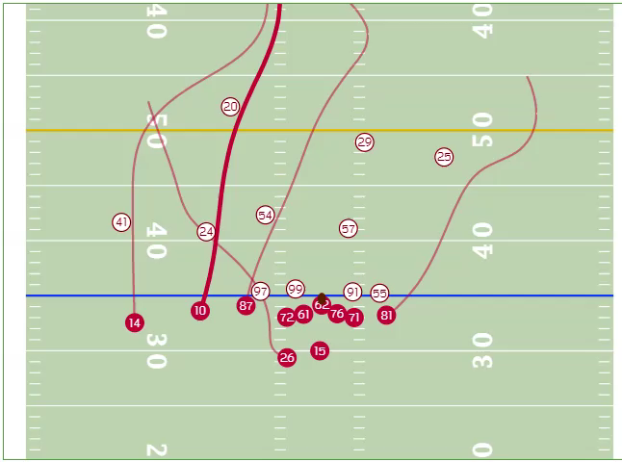
Why Plus Minus?
Don’t we have player tracking now?
Have player tracking but not overall value
Opposite order of baseball & basketball
Multiresolution framework ideal (Cervone, D’Amour, Bornn (2016) )
No player tracking in college
NFL Next Gen Stats

Slide 7
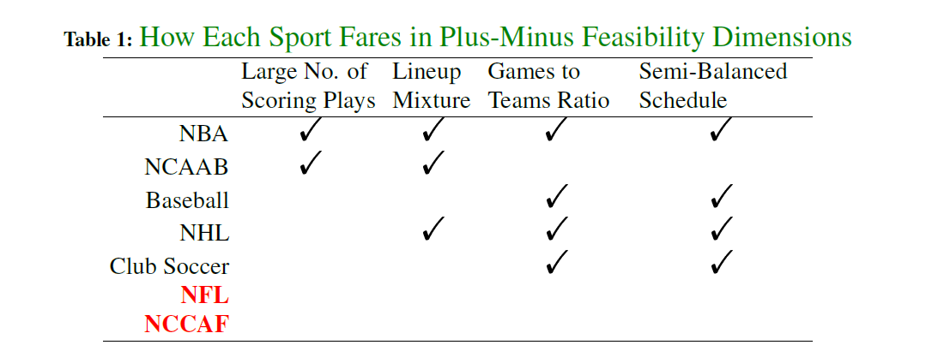
Problems with Plus Minus Approach

Slide 8
Plus-Minus Approach in Football
Few scoring plays
Use expected points
EPA on each play
Adjust for runs vs passes
Lineup Mixture
Regularization based on position
Number of players
Informed prior means for each player helps estimation
NCAA: recruiting & position
NFL: Draft (could use AV or box score data)
Unbalanced Schedules
More of an NCAAF problem

Slide 9
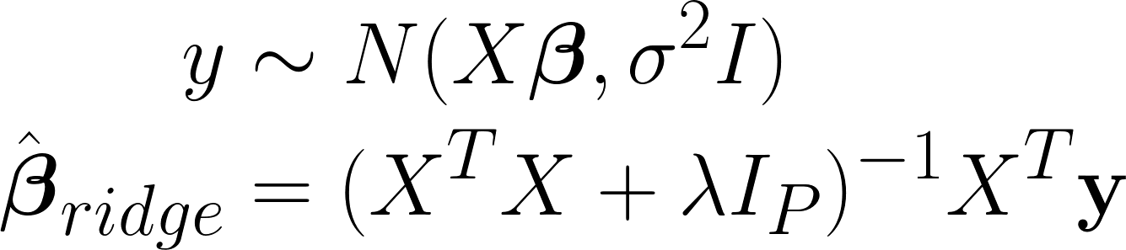

Regularization & Collinearity
Ridge regression used for past RAPM models
Recall:
Where is the penalization
Ridge regression helps with multicollinearity
Team A: 1 if on field, 0 if off.
Team B: -1 if on field, 0 if off.

Slide 10
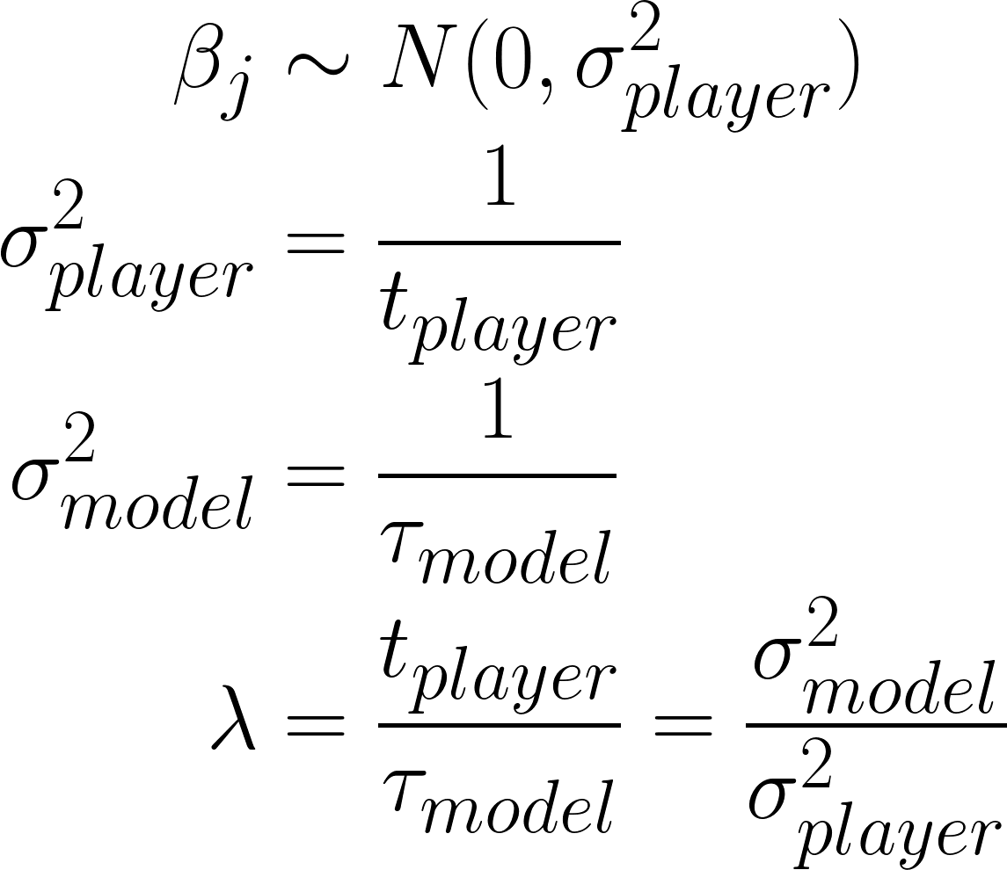
Bayesian Perspective
Assume priors:
Ridge parameter:
Ratio of model variance to prior variance

Slide 11
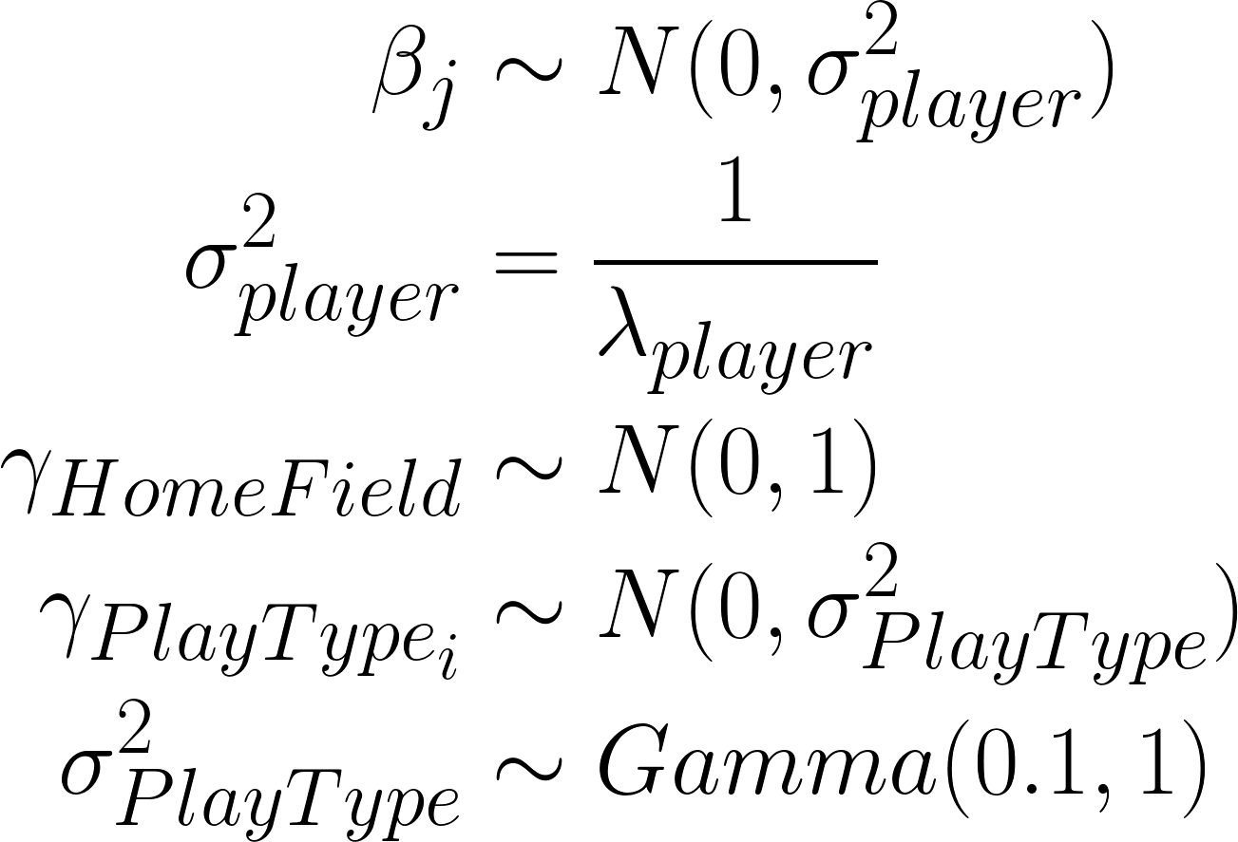
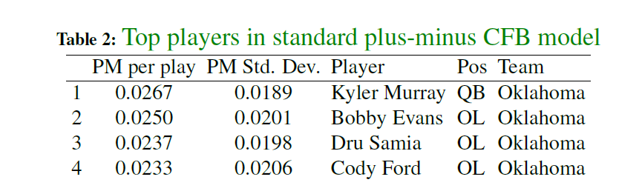
Results from Typical Framework
Plus-Minus Model for college football
2018 Results

Slide 12
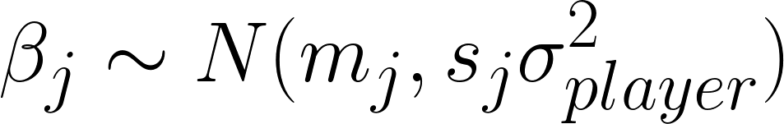
Solution
Prior variance/Shrinkage
Varies with position
s_{j} is a penalization adjustment based on the distribution of where a player lines up on the field
m_{j} is a unique prior mean for each player (will dicuss later)
In practice, I use a t-distribution prior to allow for thicker tails
S_{j} will show the variance of production across players of the same position
Higher variance = harder to replace a good player, i.e. more valuable

Slide 13
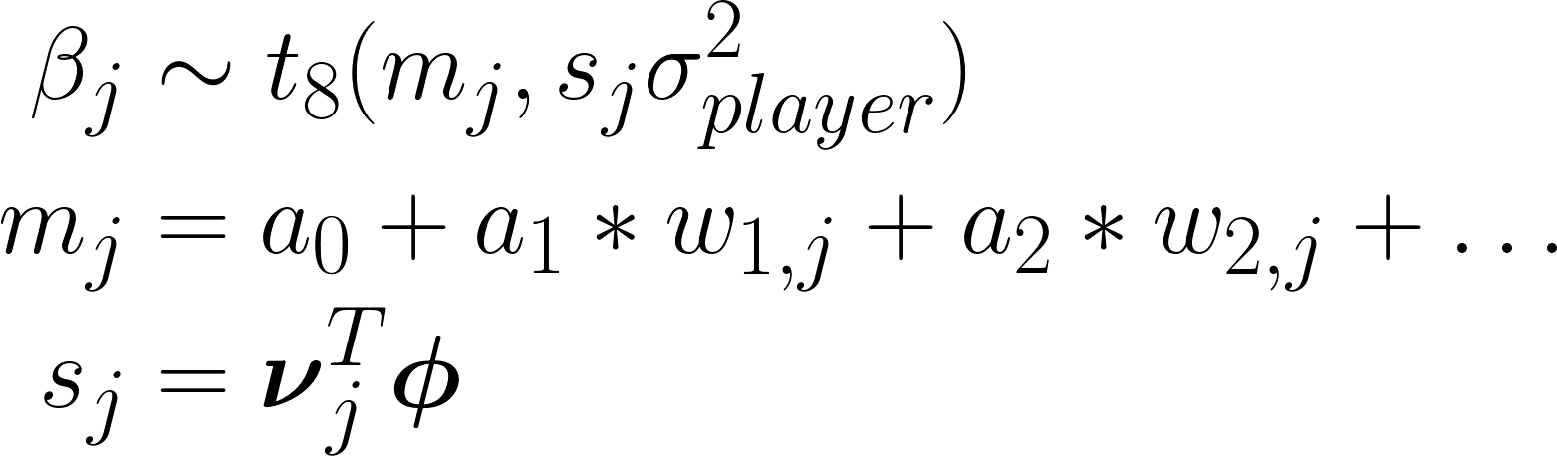


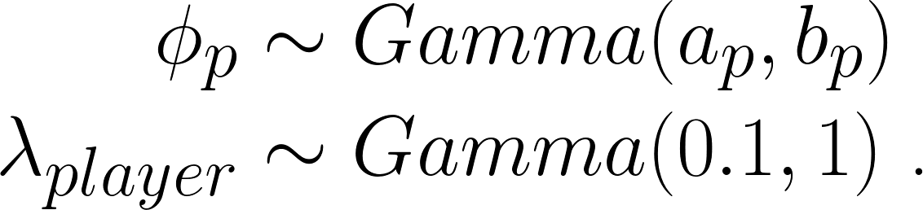
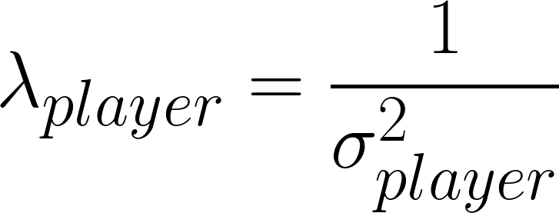
Positional Penalization Adjustment
Intuition: QB's impact game the most
Different positions impact outcome differently
Or replacement value is different
For now, mj based on position, draft, or recruiting
based on share of snaps at each position
is the multiplicative variance for position p.
is the between player precision.

Slide 14

Notes
Modeling done in STAN
Center and scale values before running
sampler slow
For NCAAF I fit a multi-year model in the NFL with uninformative priors, used those posteriors to inform stronger prior distributions for NCAAF.
Prior values in STAN code
Access sample STAN code:
https://github.com/sabinanalytics/football-plus-minus

Slide 15
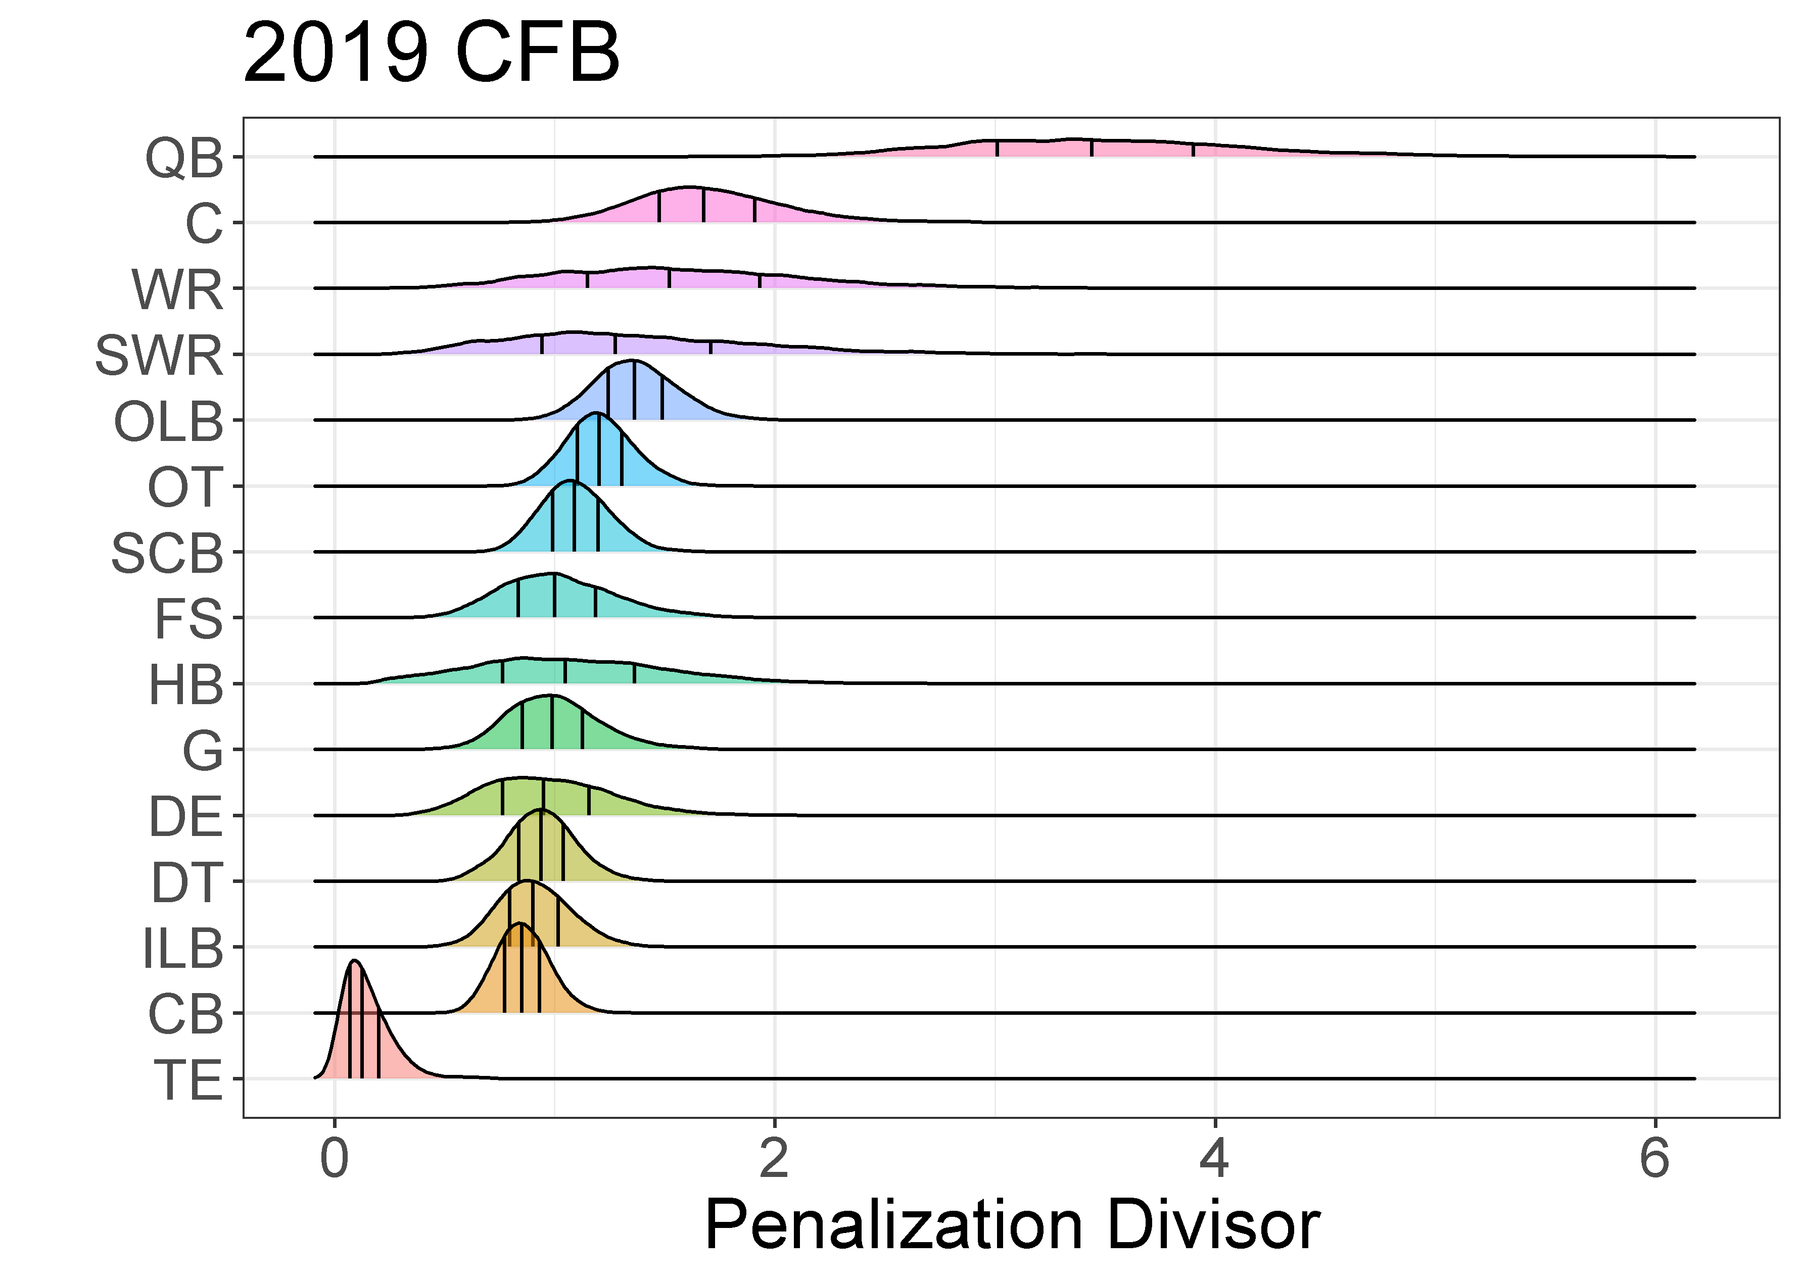
Posterior on Position Penalization
Larger variance =
Less Penalization
More positional value over replacement

Slide 16
Results
NFL
College
Last 2 MVP’s were No. 1 each year
RB’s matter more than in college
Derrick Henry, Mark Ingram, & Aaron Jones led in 2019
If a QB is in for rushes when excels at throwing (Russell Wilson) then impact isn’t as large
Next year: separate out run v pass models
Kyler Murray No. 1in 2018, Tua in 2019
Trevor Lawrence, Kedon Slovis, Zac Thomas, & Justin Fields next most impactful
Joe Burrow per play not as impactful but had much higher usage
Dillon Harris, UConn – team was average on D when on field, historically bad when off
OL for consensus good RB get much more credit than the RB himself

Slide 17
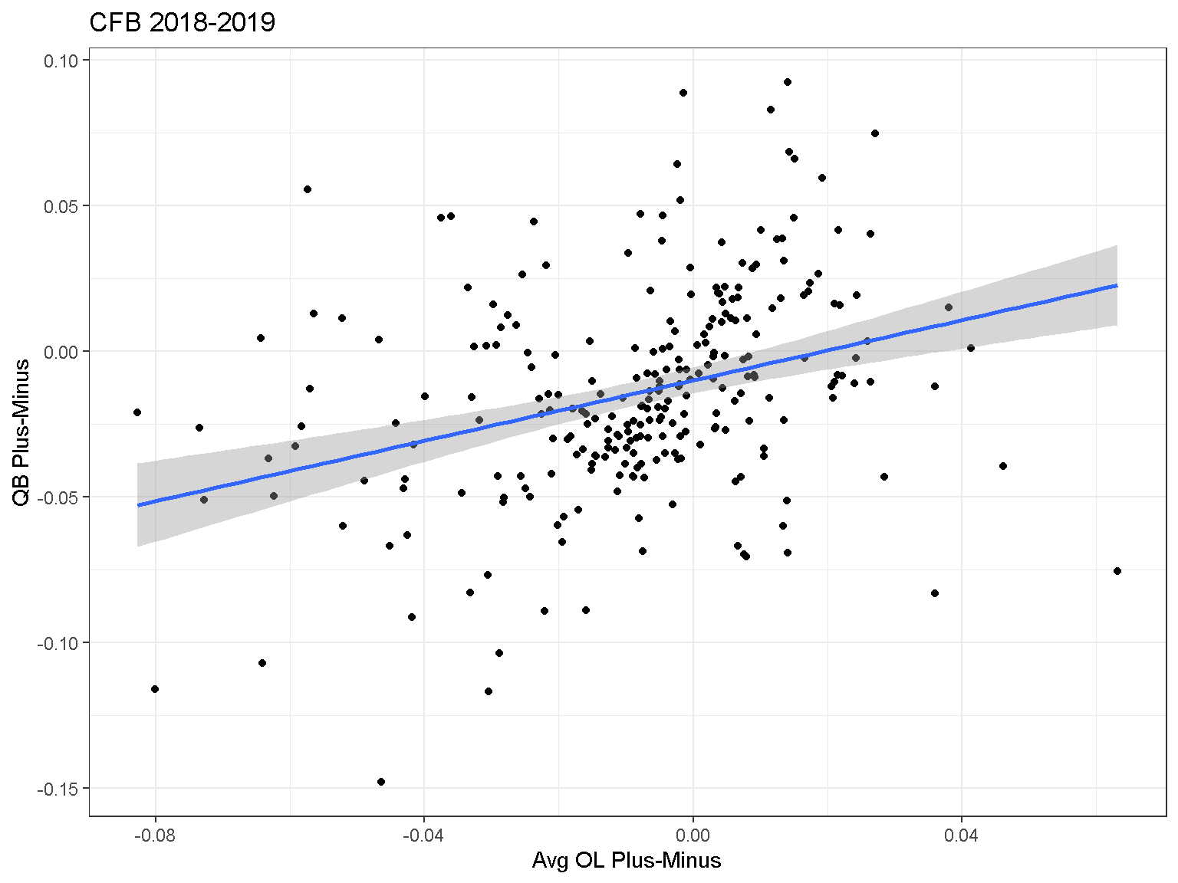
Results
Can we separate a QB from his line he shares snaps with?

Slide 18
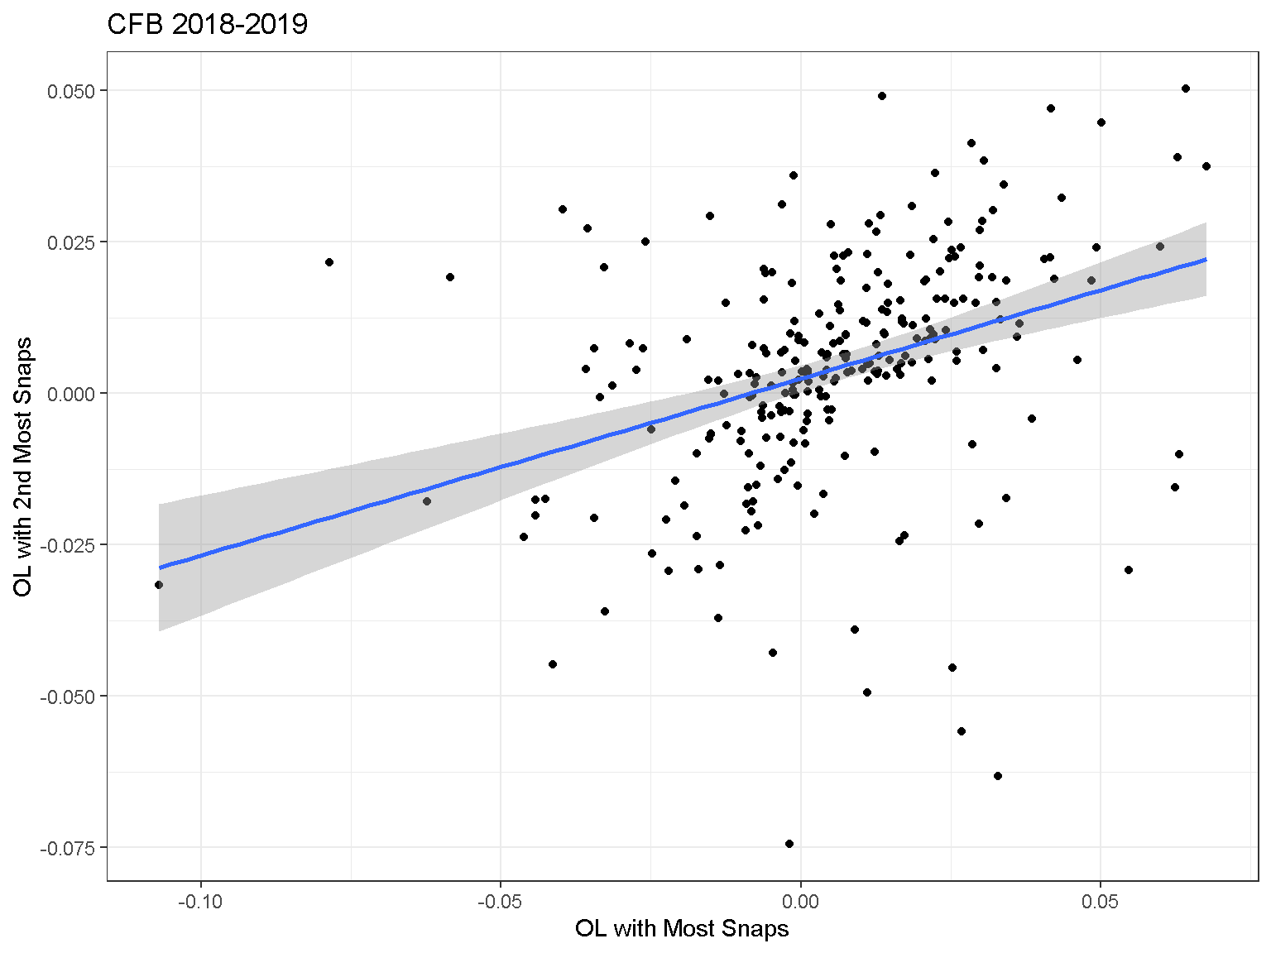
Results
Can we separate the two most used OL on the same team?

Slide 19
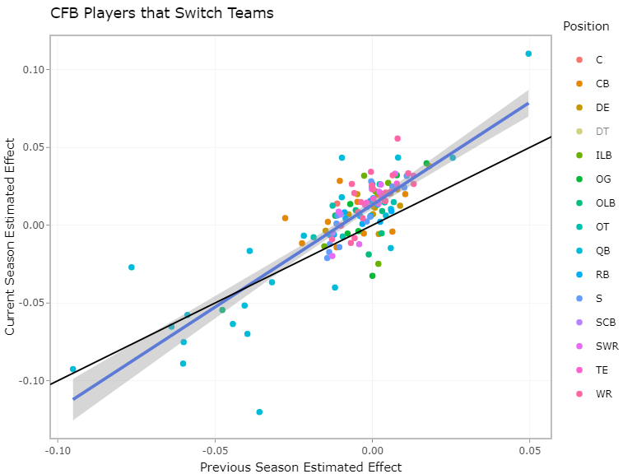
Results
Transfers in CFB tend to improve one year to next.

Slide 20
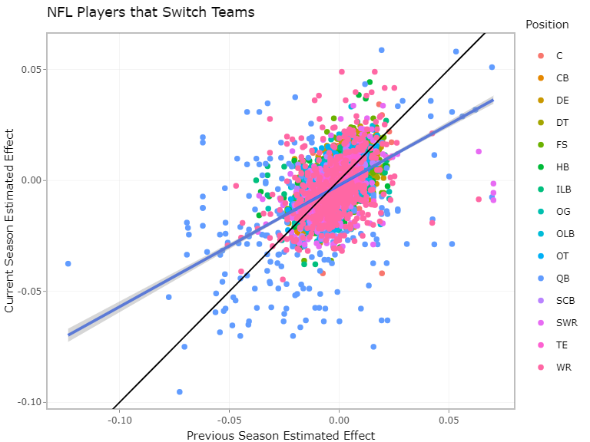
Results
NFL Players get worse after they switch teams (expected, but evidence model is working.)

Slide 21
Lessons Learned
Some random events can still bias results using EPA
Turnovers
Estimated EPA of a play when the ball is fumbled (recovered or not) based on context of fumble
Similar approach for interceptions
Predictive or descriptive?
Using last season’s estimate as prior improves overall predictiveness
Harder to capture true change (improvement or decline)
Coaching changes exacerbate this
Descriptive can use a “Box Plus-Minus” as a prior

Slide 22
Priors using Advanced Tracking Stats
Still working on this!
Would create a Box Plus-Minus
Similar to ESPN’s Real Plus-Minus (RPM)
Different for each position group
Examples:
QBR
Completion Probability over expectation (CPOE)
Pass rush wins/losses
Comp % when targeted
Avg Yds after contact

Slide 23
Questions?
Snapshot of results in CFB & NFL on github as well
https://github.com/sabinanalytics/football-plus-minus

